Slide 1
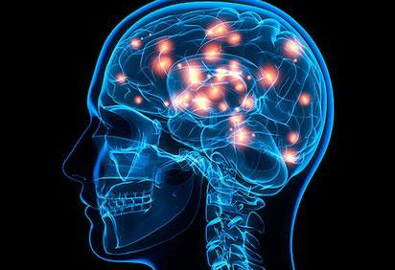
SleepA
by A.I.M.D
Krystal Yang
Rosalyn Wong
Erica Austriaco
Stephanie On
Notes:
In this slide there is a background placeholder. Click to the small icon on the center of the slide and choose an image from computer. When add an image, you must sent it to back with Right Click on Image -> Send to Back -> Send to Back.

Slide 2



Presentation Agenda
Key Facts
Market Value
Product Description
About Us
Notes:
Remind the audience/ judge that the agenda will be repeated on the bottom right corner of each slide to let them know to guide them on our presentation flow

Slide 3
Some Facts
Fatigue causes 100,000 auto crashes and 1,550 deaths a year in the U.S [3]
90% of people with Chronic sleep loss will have another associated health conditions such as depression and heart diseases [3]
Product Description
Market Value
About Us
Key Facts

Slide 4
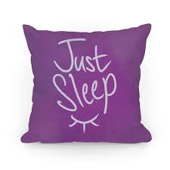
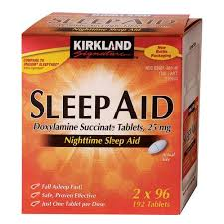
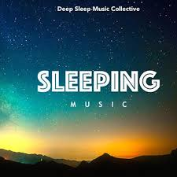
What to do?
Better Pillow?
More Pills?
Another Music?
Product Description
Market Value
About Us
Key Facts
Notes:
I think everyone here has experienced plenty sleepless nights.
Either because of an Exam that is worth more then half the marks you have earned all year, or the stress of juggle different projects and teams.
Maybe you are stressing about not being able to fall asleep!
In this fast pace society, where it feels like there are never enough hours in a day
SleepA is an analytic technology that aims for THE solution to provide every single person, with the best quality sleep EVERYNIGHT

Slide 5
Why SleepA
Sleep is that golden chain that ties health and our bodies together. -Thomas Dekker
Unipolar
Bipolar
Pseudounipolar
Unipolar
Pseudounipolar
Bipolar
ASLEEP
AWAKE
Multipolar
Multipolar
Unipolar
Bipolar
Product Description
Market Value
About Us
Key Facts
Notes:
I think everyone here has experienced plenty sleepless nights.
Either because of an Exam that is worth more then half the marks you have earned all year, or the stress of juggle different projects and teams.
Maybe you are stressing about not being able to fall asleep!
In this fast pace society, where it feels like there are never enough hours in a day
SleepA is an analytic technology that aims for THE solution to provide every single person, with the best quality sleep EVERYNIGHT

Slide 6
Product Description
SleepA is an analytical tool which uses EEG and EOG data to determine the user’s sleep quality
Motivation
This tool can branch into applications catered to a patient, a technician, or a general population
ABILITY
USE CASE
Product Description
Market Value
About Us
Key Facts
Notes:
Many health concerns such as :
Heart disease
Heart attack
Heart failure
Irregular heartbeat
High blood pressure
Stroke
Diabetes
Have been associated with chronic sleep loss.

Slide 7
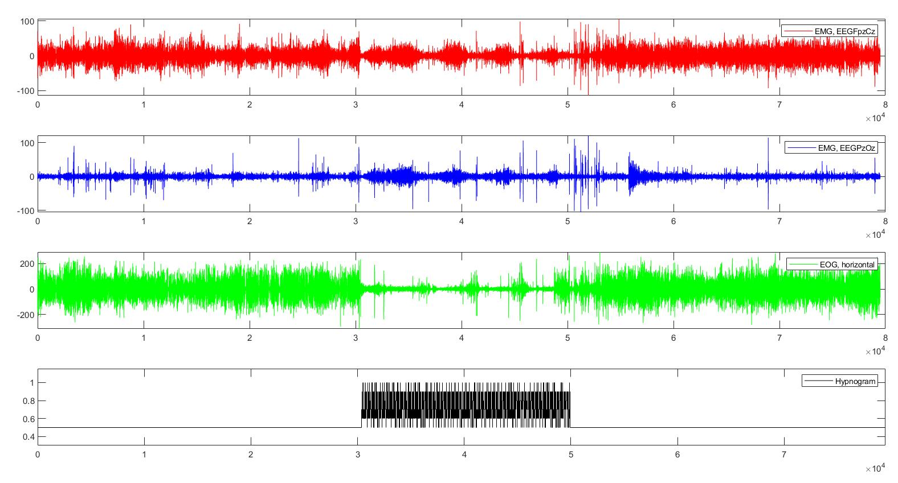
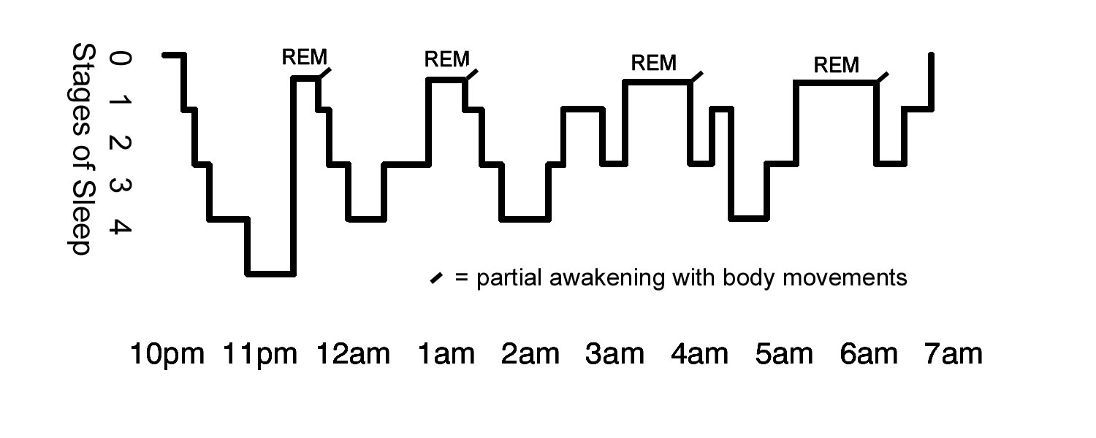
Datasets
153 polysomnographic (sleep study) recordings [1]
Quantitative data:
EEG data (Fpz-Cz and Pz-Oz)
EOG (horizontal)
EMG (submental chin)
Oro-Nasal Respiration
Rectal body temperature
Qualitative data:
Hypnogram
Product Description
Market Value
About Us
Key Facts
Notes:
EEG: electrical activity in the brain
EOG: movement of the eye
EMG: muscle -- under chin

Slide 8
Machine Learning
80 Million
Data Points
EEG
Random Forest Aggressive
Five Sleep Stages
EOG
87%
Accuracy
EMG
Product Description
Market Value
About Us
Key Facts

Slide 9
Our Target Market
Everyone can benefit from a better sleep!
SleepA has potential for a wide variety of applications:
Assist health professionals to diagnose fatigue, insomnia, and other sleep disorders
Provide accessible sleep data for the general user
Product Description
Market Value
About Us
Key Facts

Slide 10

Thank you !

Slide 11


References
[1] “The Sleep-EDF Database [Expanded],” Physionet, 28-Feb-2016. [Online]. Available: https://www.physionet.org/physiobank/database/sleep-edfx/?fbclid=IwAR3TsByHU5uOZv-a8TH4_kMAQ90ZmNIvtUZkHYVthxcqr4rmoXTeh8hxDaw. [Accessed: 16-Feb-2019].
[2] “Stages of Sleep - Non-REM and REM Sleep Cycles,” Tuck Sleep, 19-Dec-2018. [Online]. Available: https://www.tuck.com/stages/. [Accessed: 16-Feb-2019].
[3] C. Peri, “10 Surprising Effects of Lack of Sleep,” WebMD. [Online]. Available: https://www.webmd.com/sleep-disorders/features/10-results-sleep-loss#1. [Accessed: 16-Feb-2019].

